Slide 1

Analyzing Music Listening Trends (Popularity, Audio Features, and Patterns Using Spotify Data
Ehsan Kahrizi and kishore ragul

Slide 2
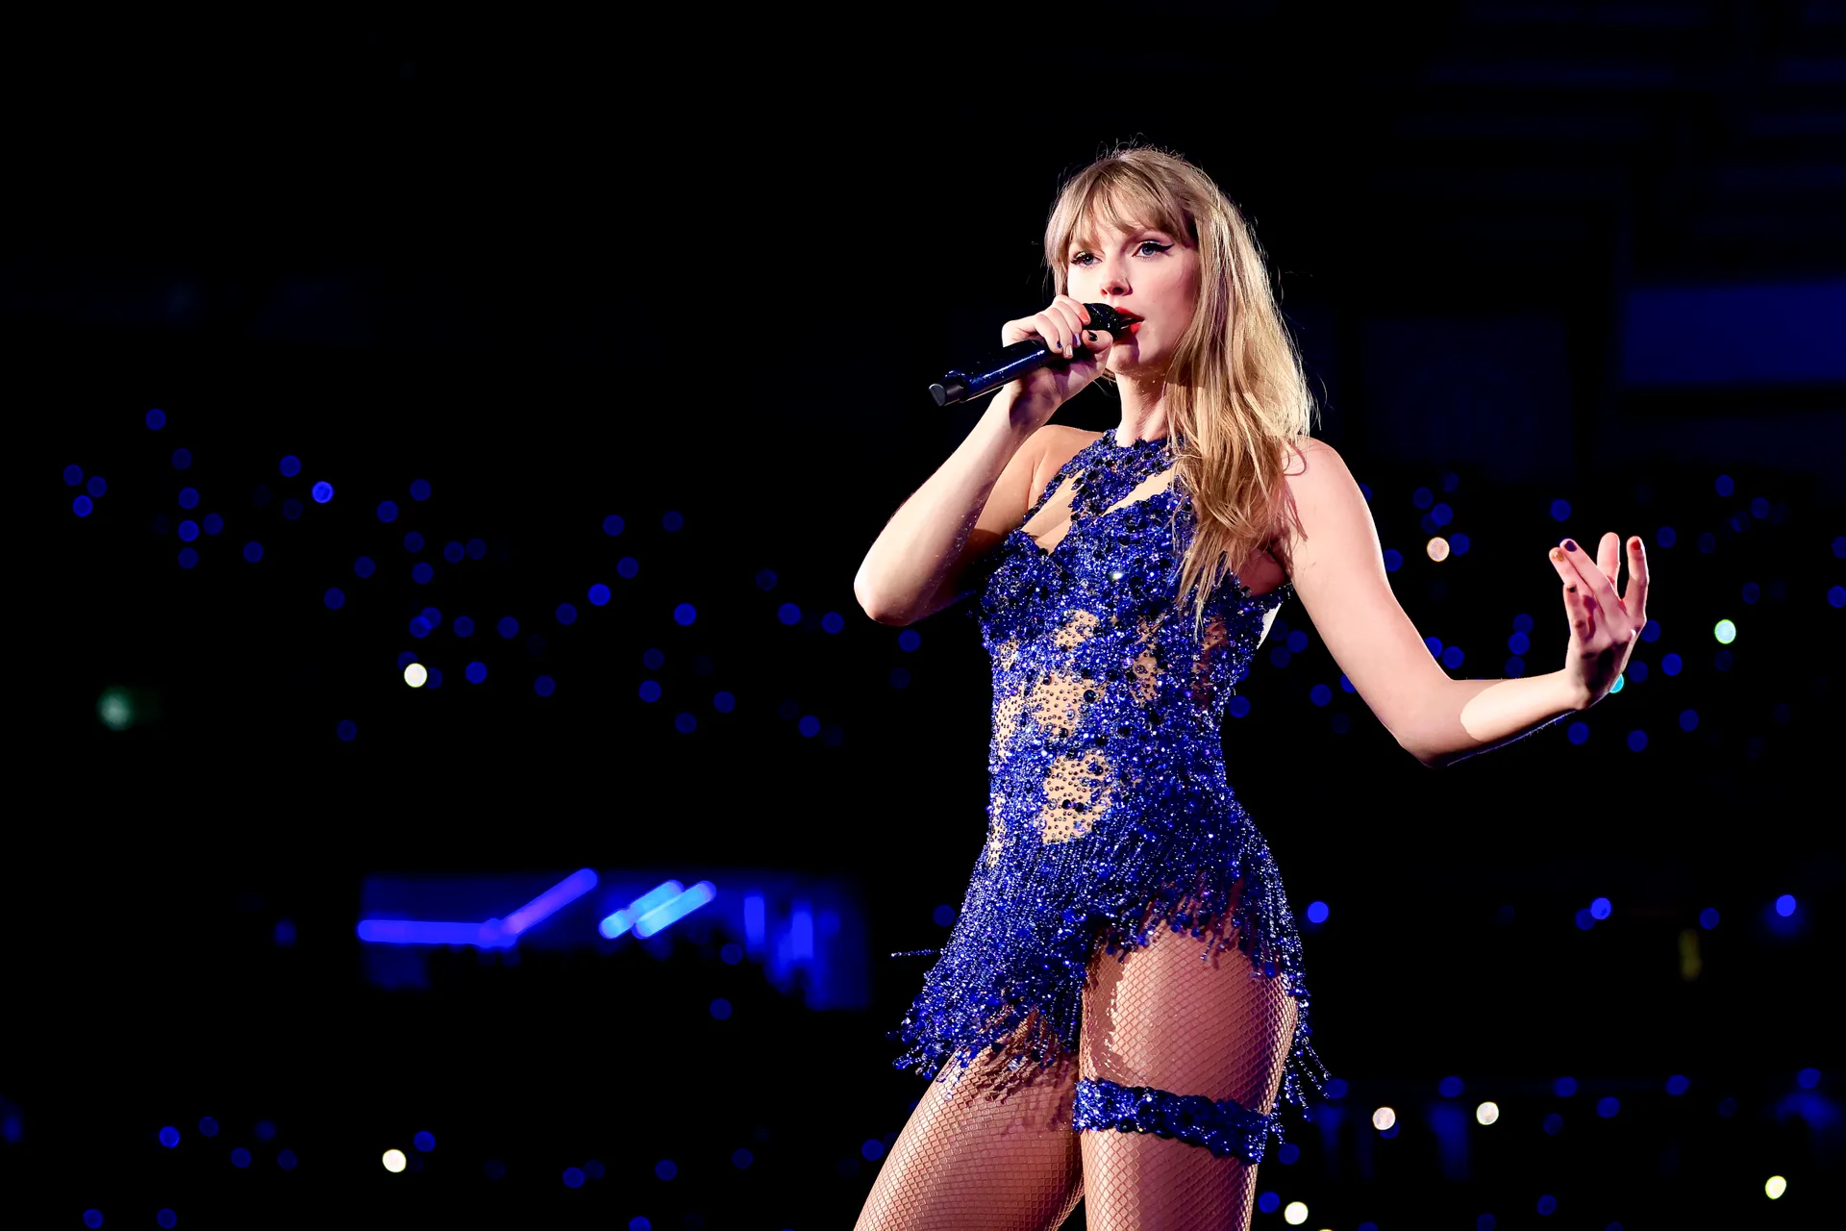




Taylor Swift
Bruno Mars
The Weeknd
Billie Eilish

Slide 3
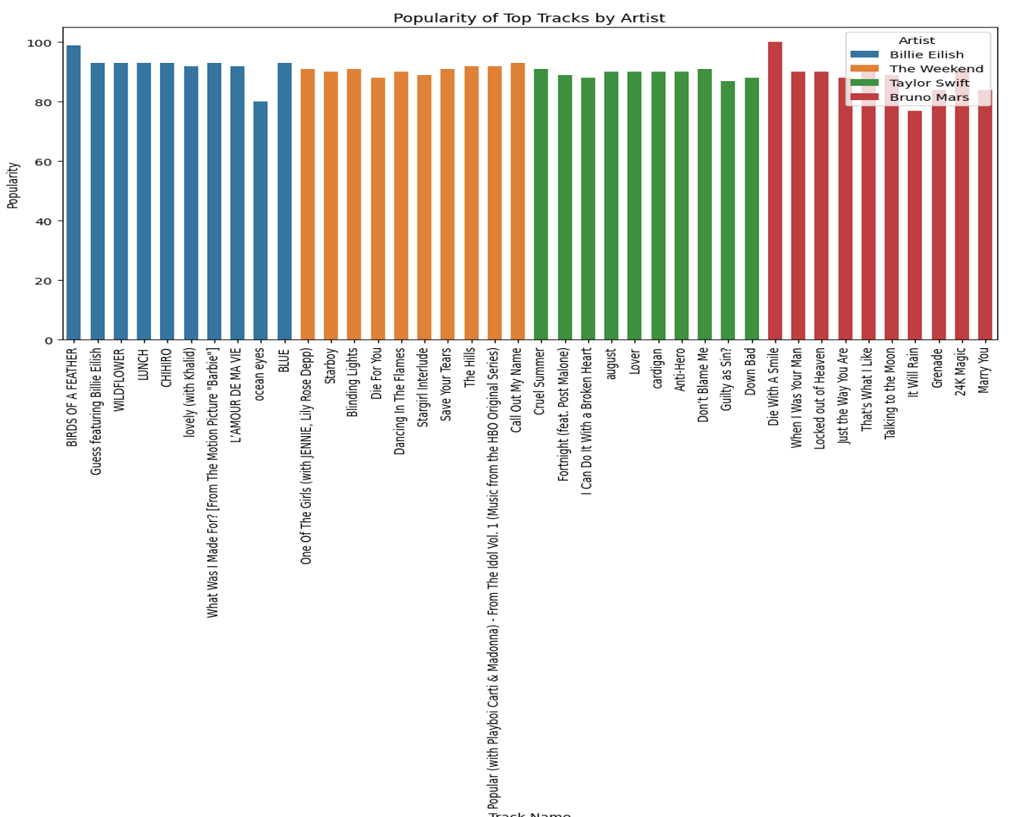
Most popular tracks
Top tracks of four artists:
Billie Eilish
The Weeknd
Taylor Swift
Bruno Mars
Billie Eilish (Birds of a feather)
and
Bruno Mars's top tracks (Die with a smile)

Slide 4
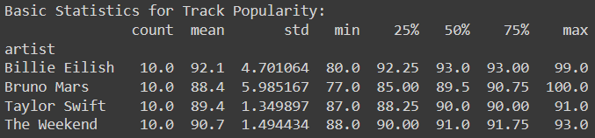
Descriptive statistics for track popularity across four artists
Mean (Average)
Standard Deviation (std)
Minimum (min)
Maximum (max)
Percentiles (25%, 50%, 75%)
Billie Eilish has the highest mean popularity (92.1) with low standard deviation

Slide 5
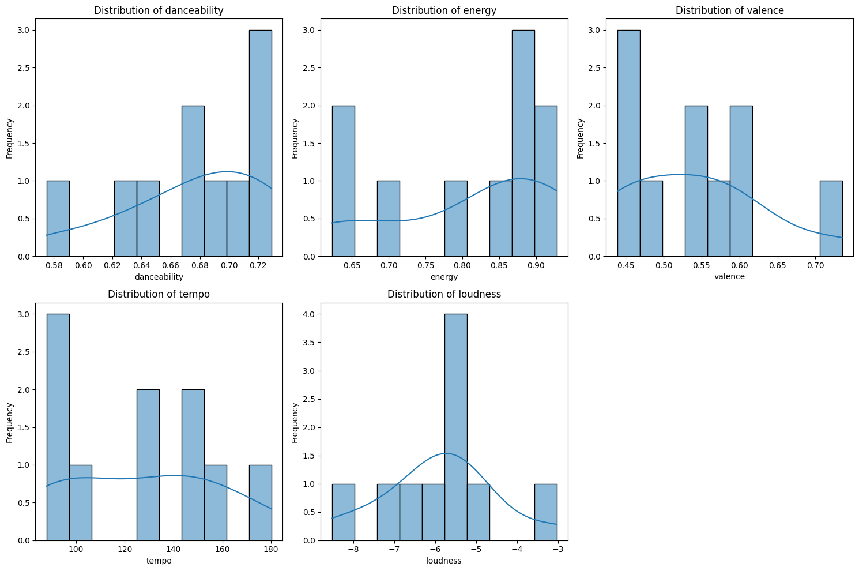
Distribution of five audio features:
danceability
energy
Valence => positivity of a song
tempo => beats/min
loudness
The danceability and energy features show relatively uniform distributions
Similarity between the distributions of Valence and Tempo distribution, indicating that we have the highest frequency in low-range beats/min and low-range Valence.
The loudness (dB) clusters around a specific range

Slide 6
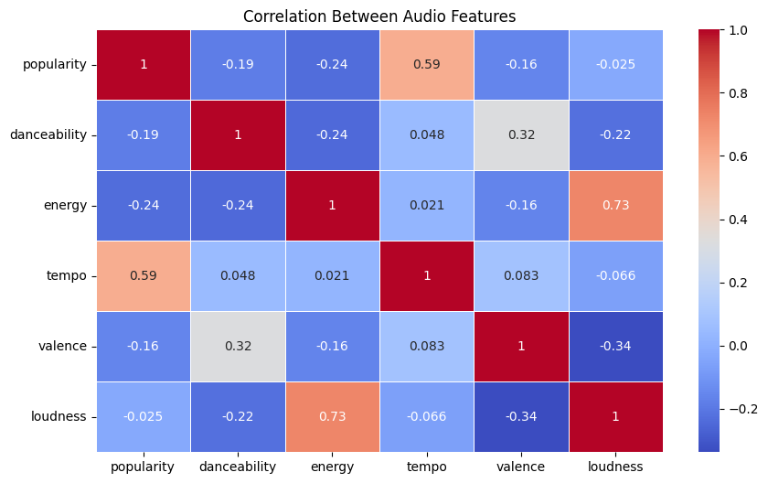
Correlation matrix between the audio features
The strongest positive correlation that we have seen is between energy and loudness, which is around 0.73.
The second top positive correlation is a moderate positive correlation between tempo and popularity, around 0.59.
Weak correlations are observed between popularity and danceability, which is around -0.19, and also valence and energy, which is -0.16.

Slide 7
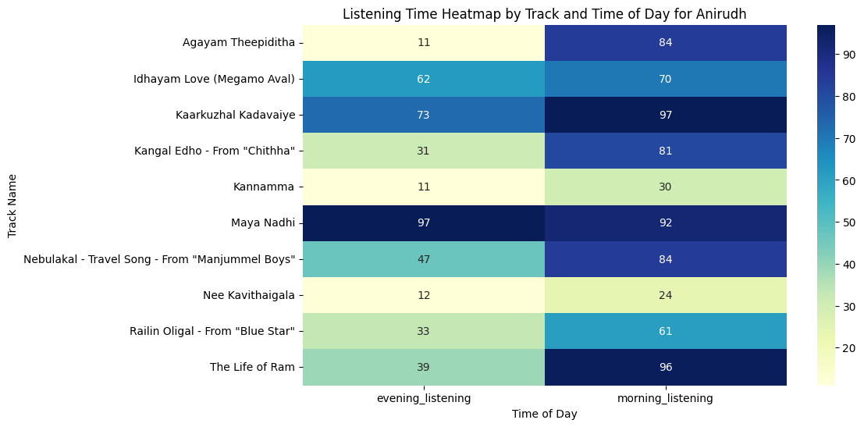
Listening to songs at different times (Morning and Evening)
All the tracks in the morning are more listened.
"Maya Nadhi" has the highest listening time in both the morning and evening.

Slide 8
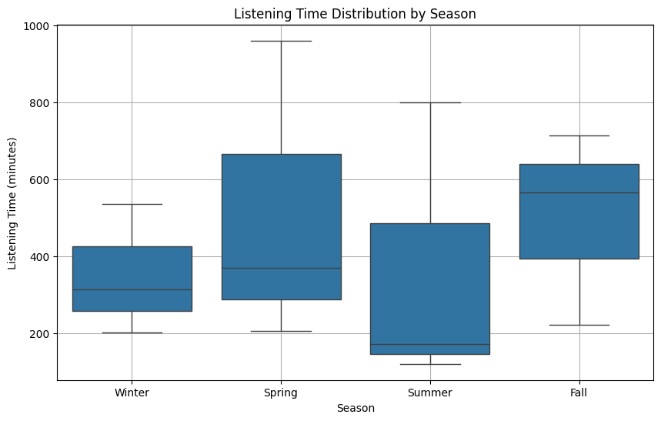
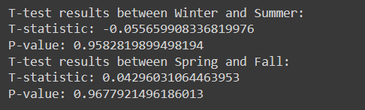
Seasonality patterns (Winter, Spring, Summer, and Fall)
The Spring has the highest median listening time
The range of listening times in Spring and Fall is wider in comparison with Winter and Summer.
The t-test: no statistically significant differences in listening times
Winter and Summer => 0.958.
Spring and Fall => 0.968.

Slide 9
Track Popularity Distribution: The bar chart analysis shows that Billie Eilish and Bruno Mars's tracks generally have higher popularity scores compared to others. This indicates that their music resonates more with listeners in the dataset.
Descriptive Statistics: Also, we found that the Weeknd's tracks have the most consistent popularity scores (low standard deviation), while Bruno Mars has the widest range of popularity that indicates varied reception among his tracks.
Audio Feature Analysis: For analyzing the future of the track, we found that High energy and loudness are positively correlated, which indicates a strong relationship between these features in popular tracks.
Time-of-Day Listening Patterns: The listening time heatmap shows that most tracks are more popular in the morning. Also, some tracks like "Maya Nadhi" have consistently high listening times during both morning and evening.
Seasonal Listening Behavior: The seasonal box plot shows that listening times vary across seasons, with Spring having the highest median listening time. But, the t-test results tell us that these variations are not statistically significant, so we can say that seasonal changes do not have a major effect on listening generally.

